Slide 1

GB Bicycle Accidents Visualization
Information Visualization 364.2.1721
Prof. Gilad Ravid
Eviatar Rosenberg, Oriel Perets, Tal Barda
Eviatar Rosenberg, Oriel Perets, Tal Barda

Slide 2
Presentation Plan
Data Understanding
Data Preparation
Visualizations
Related Work
Conclusion
Introduction
Eviatar Rosenberg, Oriel Perets, Tal Barda

Slide 3
Introduction
In the United Kingdom, Cycling is 1% of the mileage accrued by all vehicular road traffic.
42% of people aged 5+ own or have access to a bicycle, equal to 22 million people.
On average, males of all ages made three times as many cycle trips as females.
People were more likely to cycle for leisure than for travel.
Younger age groups are more likely to cycle than older age groups.
UK comes towards the bottom of the list of 28 countries in Europe.
Regarding the pandemic, these statistics don’t go beyond 2018, And therefore they do not reflect significant changes in travel behavior during the lockdown.
Eviatar Rosenberg, Oriel Perets, Tal Barda

Slide 4
Presentation Plan
Data Understanding
Data Preparation
Visualizations
Related Work
Conclusion
Introduction
Eviatar Rosenberg, Oriel Perets, Tal Barda

Slide 5
Data Understanding
Collected from Kaggle.com
Bicycle accidents in GB over the years 1979-2018
2 Tables:
Accidents – 10 fields
Bikers – 4 fields
Connected via a unique ID field
Biker
Field Name | Type | Values | Explanation
ID | String, Unique | Unique | Identifier
Age_Grp | String | [6 to 10, 11 to 15, 16 to 20, 21 to 25, 26 to 35, 36 to 45, 46 to 56, 56 to 65, 66 to 75] | The age group of the biker involved in the accident
Gender | String | [Male, Female, Other] | Gender of the biker
Severity | String | [Slight, Serious, Fatal] | Severity of the casualty in the accident
Eviatar Rosenberg, Oriel Perets, Tal Barda

Slide 6
Accident
Field name | Type | Values | Explanation
ID | String, Unique | Unique | Unique identifier for the accident
# of Vehicles | Int | (1, 13) | # of vehicles involved
# of Casualties | Int | (0, 13) | # of Casualties in the accident
Date | Date | 1.1.79-31.12.18 | The Date of the accident
Time | Time | 00:00-23:59 | The time of the accident
Speed Limit | Int(km/h) | (10, 70) | Speed limit of the road of the accidents
Road type | String | [SC, DC, RA, OWS, SR] | Type of road of the accident
Road Condition | String | [Dry, Wet, Frost, Flooded, Snow] | Condition of the road of the accident
Weather Condition | String | [Fog, Rain, Clear, RW, Snow, SW, CW] | Weather condition the time of the accident
Day | String | [Sun, Mon…, Sat] | The day of the week
Eviatar Rosenberg, Oriel Perets, Tal Barda

Slide 7
Presentation Plan
Data Understanding
Data Preparation
Visualizations
Related Work
Conclusion
Introduction
Eviatar Rosenberg, Oriel Perets, Tal Barda

Slide 8

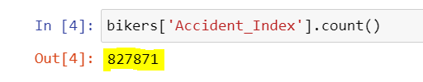
Outliers and Missing Values
Records Count:
Outliers:
Ignoring ‘other’ values from Gender variable: 119 records
Ignoring values larger than 70 from Speed_limit variable: 1 record
Missing values:
Ignoring ‘Missing data’ and ‘Unknown’ values from Weather_conditions variable: 24,235 records
Ignoring ‘Missing data’ values from Road_conditions variable: 1,648 records
Eviatar Rosenberg, Oriel Perets, Tal Barda

Slide 9
Presentation Plan
Data Understanding
Data Preparation
Visualizations
Related Work
Conclusion
Introduction
Eviatar Rosenberg, Oriel Perets, Tal Barda

Slide 10
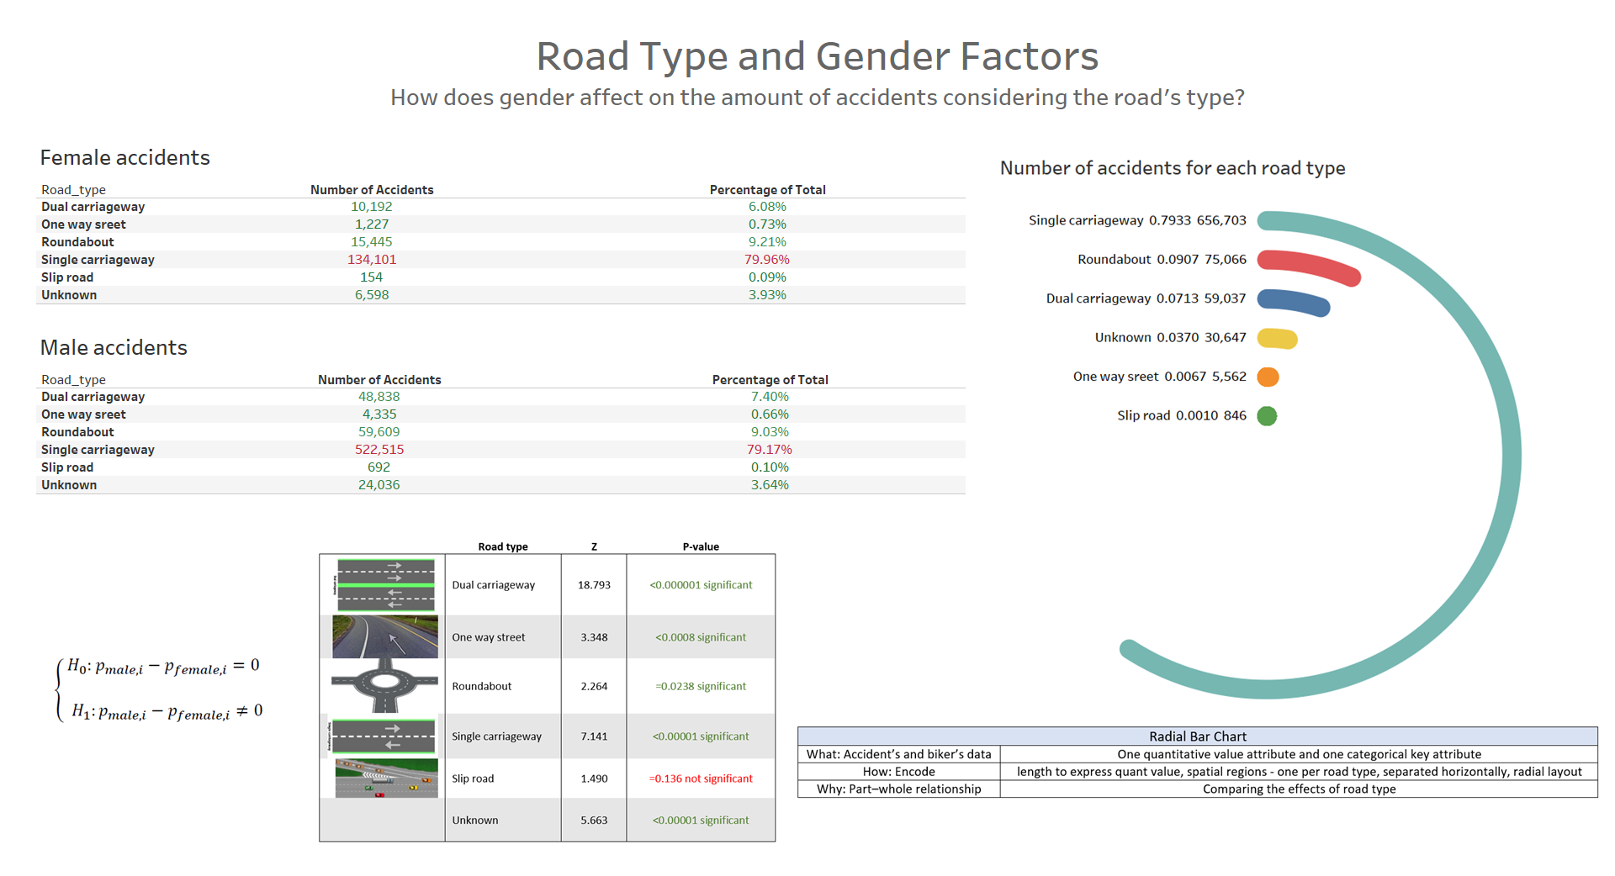

Slide 11
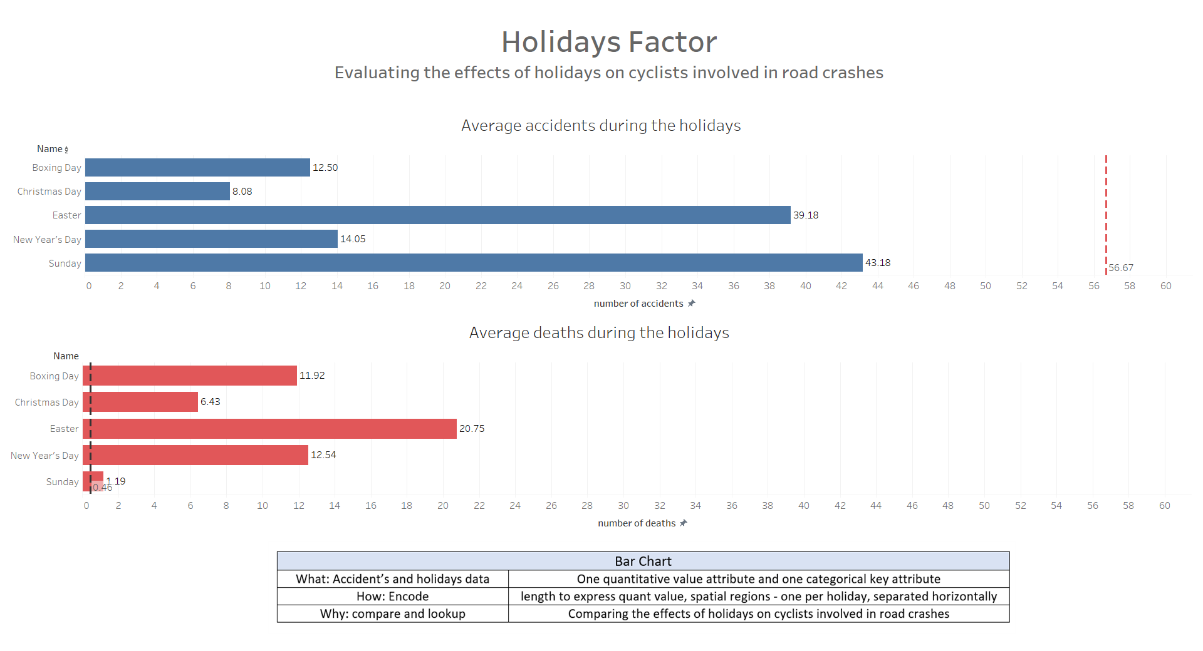

Slide 12
Presentation Plan
Data Understanding
Data Preparation
Visualizations
Related Work
Conclusion
Introduction
Eviatar Rosenberg, Oriel Perets, Tal Barda

Slide 13
Related Work
Accidents in Moscow
Maksim
Motor Accidents In NY
Madan
Eviatar Rosenberg, Oriel Perets, Tal Barda

Slide 14
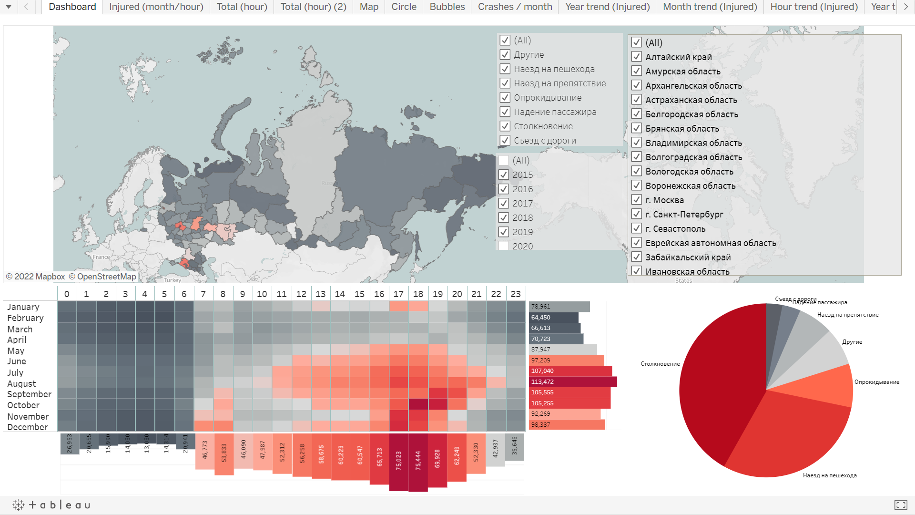
Related Work
Evyatar Rosenberg, Oriel Perets, Tal Barda

Slide 15
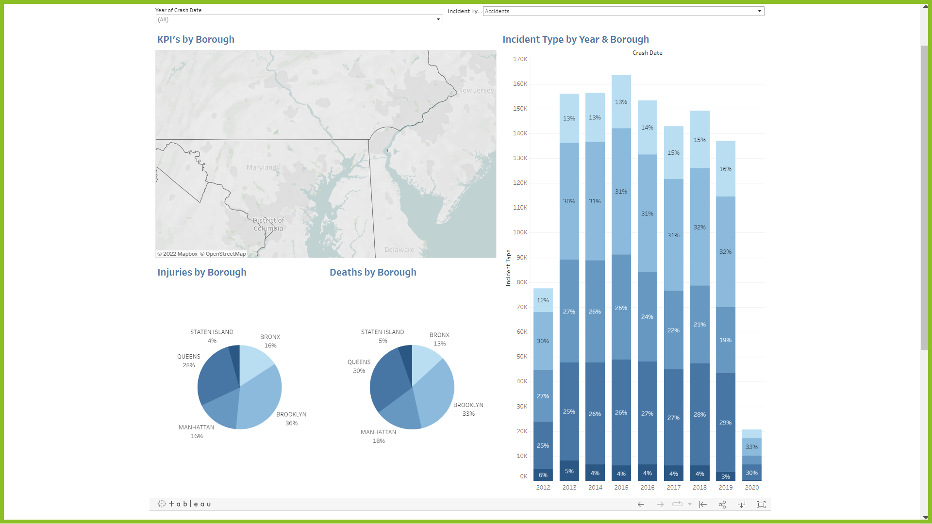
Related Work
Evyatar Rosenberg, Oriel Perets, Tal Barda

Slide 16
Presentation Plan
Data Understanding
Data Preparation
Visualizations
Related Work
Conclusion
Introduction
Eviatar Rosenberg, Oriel Perets, Tal Barda

Slide 17

Thank you!
Eviatar Rosenberg, Oriel Perets, Tal Barda

